Slide 1



Credit Card Fraud Analytics
Team:
Gyan Prakash, Yufei Wang, Wei Tang, William Staudenmeier,
Alok Abhishek, Weichen Zhang, Pratyush Shankar

Slide 2
Executive Summary
Objective
Build a supervised learning model to detect fraudulent credit card transactions
Data Analysis Methods
5 step approach from data exploration, imputation, expert variable creation, feature selection and data modeling
Conclusions
Our best model, Bootstrap Forest, gave an FDR at 2% of 52.37% on OOT dataset.

Slide 3
Problem Statement
About 31.8 million U.S. consumers had their credit cards breached in 2014
As per studies in 2007 for every $100 of transaction $0.07 was lost due to fraud
As part of this project we are building a supervised learning model to identify fraudulent credit card transactions

Slide 4
Process Overview
Data Discovery and initial analysis
Data Visualization and understanding
Expert variable creation
Data imputation
Feature Selection (KS + Forward selection)
Data Partition – Training, OOT and Testing
Predictive Modeling

Slide 5
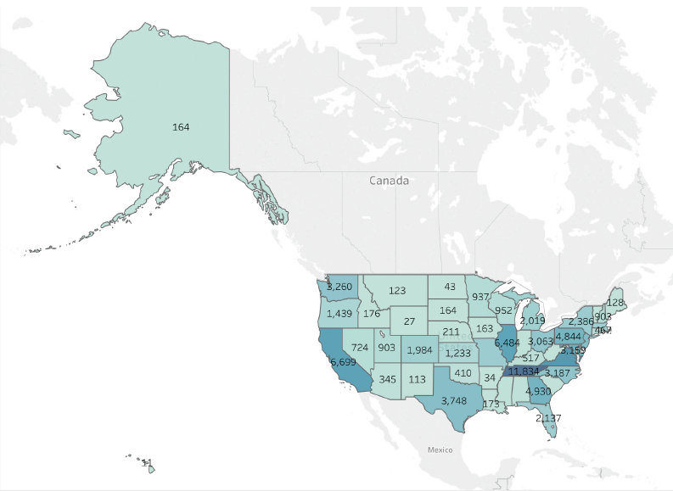
Data Description
One year of credit card transaction data for Gov. Agency
96,707 sample transaction labeled with fraud/not fraud
6.26 MB and 10 columns
The data contains following information:
Card number
Date of transaction
Merchant number
Merchant description
Merchant state
Merchant zip
Transaction type
Transaction amount
Fraud label

Slide 6
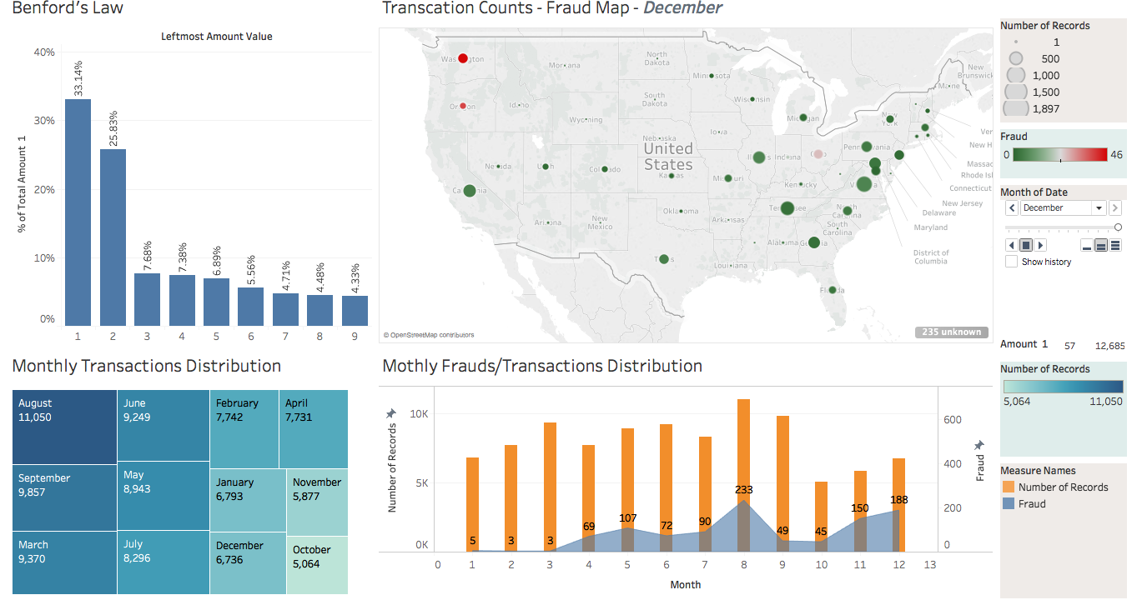
Data Visualization

Slide 7
Data Cleaning
Three variables -- merchnum, merch.state and merch.zip are not 100% populated, with missing values and 0’s.
We assigned values to these fields based on merch.description. We considered records with different merch.description as different merchants, and assumed that each merchant should have a unique merchant number, be in one state, and only have one zip code.
We skipped missing values while counting linkages to create expert variables
Since all these three variables are categorical, we assigned unique values in these fields according to merch.description, and those values were designed to be quite different from other existing values

Slide 8





Expert Variable Creation
Type I variables are intended to capture unusual amounts of transaction, both at the card level and the merchant level
Type 2 variables are intended to capture unusual transaction frequency during a set period of time, both at the card level and the merchant level
Type 3 are location related variables, which are intended to capture merchants with different zip codes and states in a set period of time.
Type 4 are intended to catch card appearance pattern, either for a merchant or for a card holder.

Slide 9
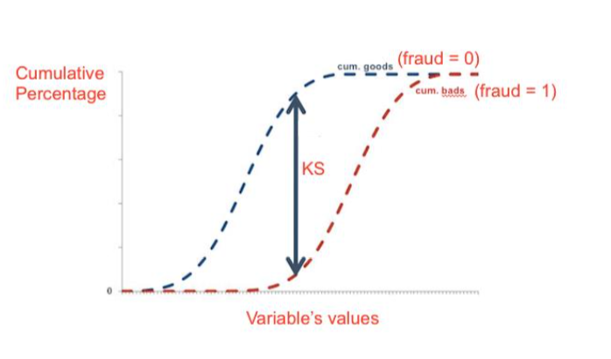
Feature Selection - KS & Lasso
KS Lasso
130 variables →→ 40 variables →→ 25 variables

Slide 10
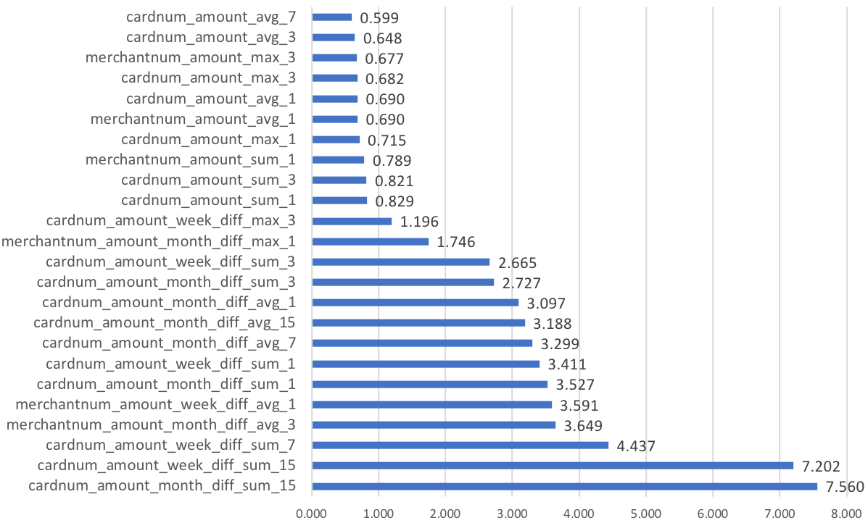
Gini Index – Variable Importance

Slide 11
FDR at 2% for Different Models
 | Bootstrap Forest | Boosted Trees | Neural Network | Naive Bayes | Logistic Regression
Training | 66.51% | 64.41% | 70.89% | 59.98% | 62.13%
Testing | 58.94% | 53.61% | 60.08% | 50.00% | 49.05%
OOT | 52.37% | 51.48% | 42.31% | 38.78% | 47.63%

Slide 12
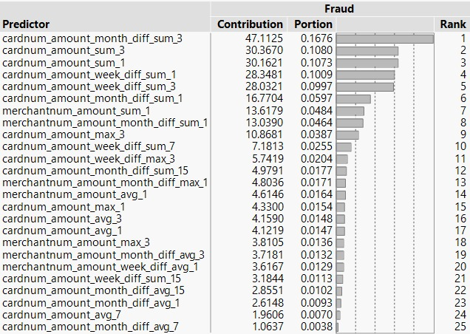
Variable Importance based on Bootstrap Forest

Slide 13
ROC Curve – Bootstrap forest

Slide 14
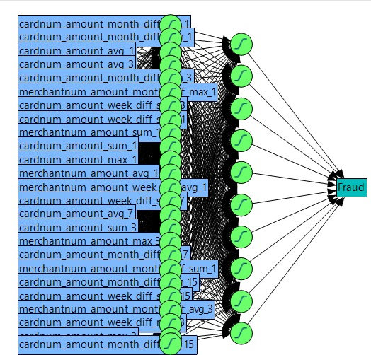
Neural Network (Nodes: 25, 10)

Slide 15
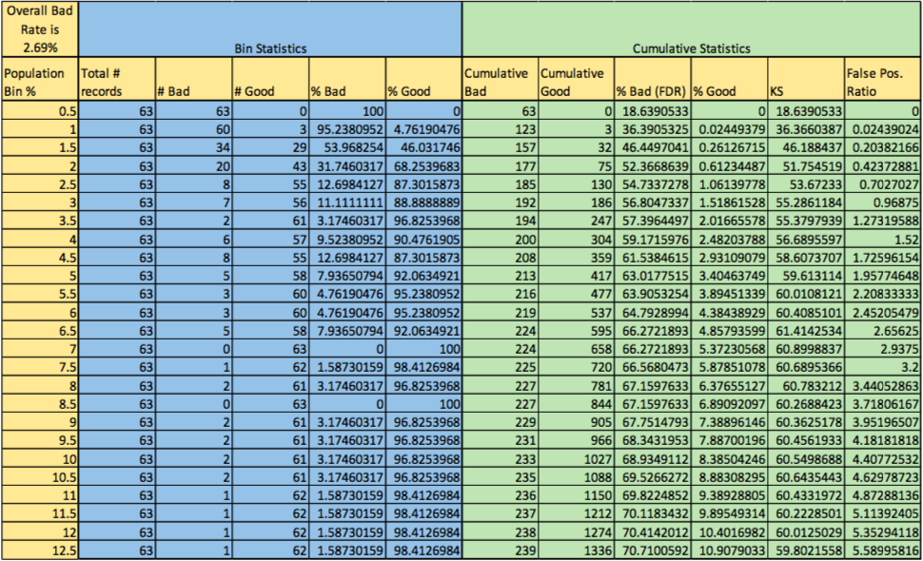
Bin Table

Slide 16
Conclusion
$23,700
Assume $1000 loss for every fraud that’s not caught
Assume $10 loss for every false positive (good that’s flagged as a bad)
Cut off: 16.5%
12,586

Slide 17
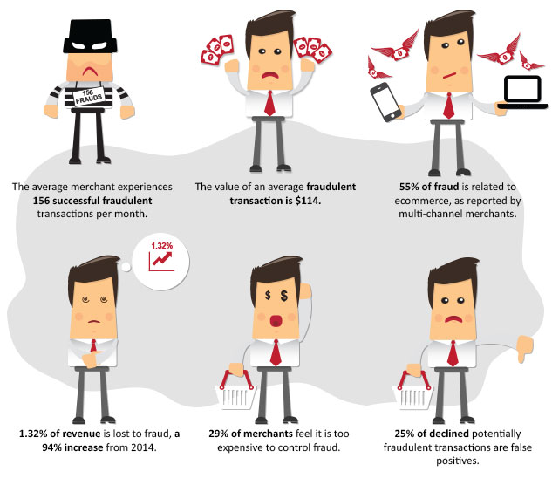
Business Insights

Slide 18
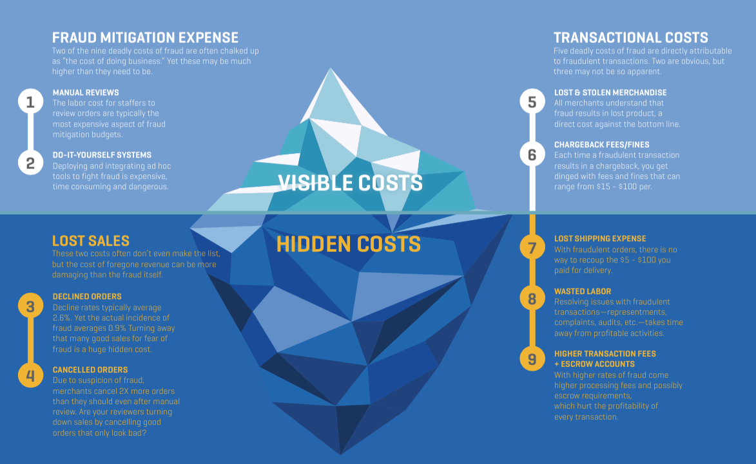
Business Insight

Slide 19
Thank You!

Slide 20

Q&A

Slide 21

Expert Variable Creation
We created 130 expert variables and we kept 40 variables after KS.
Since this analysis involves time, with limited data, we chose four different time windows 1, 3, 7, 15 and 30 days. The rationale is to capture more (and different types of) fraudulent records that might be detected in those time windows.
Furthermore, we kept 25 variables after Lasso, we use these 25 to train our models.

